Slide 1
Ragazzini Method and Robust Control
Direct design method of Ragazzini
  Causality, stability, and steady-state constraints
Robust Control
  Sensitivity function
  Stability robustness

Slide 2






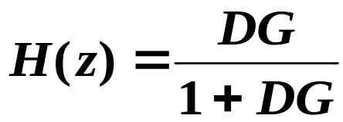
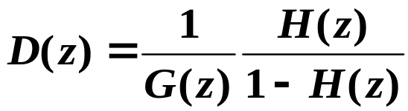





Direct Design Method of Ragazzini
Σ
There must be some necessary constraints on H(z) (and hence D(z)) so that D(z) is implementable.
D(z) causal: D(z) must be well behaved as
If G(z) has zeros at
Constraint 1: H(z) must have a zero at infinity of the same order as the zero of G(z) at infinity.

Slide 3

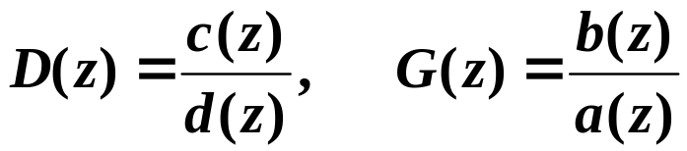
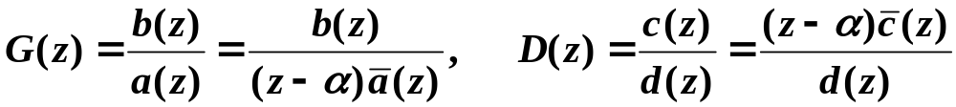
Also want the C.L. system to be stable
Define:
Suppose D(z) cancels a pole or zero of G(z):
G(z) has a pole at z = α that is cancelled by D(z).

Slide 4

If D(z) should not cancel a pole or zero of G(z):
If D(z) does not cancel pole:
If D(z) does not cancel zero:
Constraint 2: 1 - H(z) must have roots at all poles of G(z) on or outside unit circle.
Constraint 3: H(z) must have zeros at all zeros of G(z) on or outside unit circle.

Slide 5

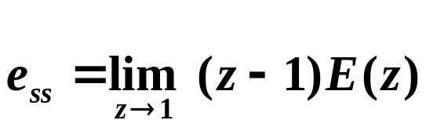


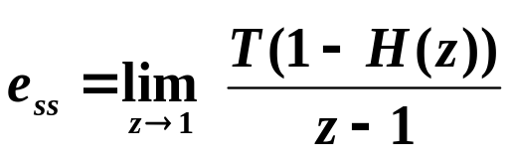
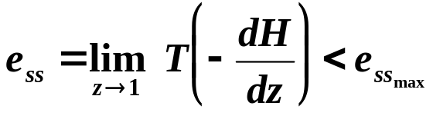
Generally also want to meet some steady-state requirements
H(z) is the overall transfer function.
Steady-state error to a unit step:
Type 0
If
If want C.L. system to be Type 1
L’Hopital’s:
Type 1

Slide 6


Robust Control
Discussion here applies equally well to continuous-time and discrete-time systems.
GM, PM, and ω_{c} are point specifications.
A more accurate “margin” can be given in terms of the sensitivity function, and this function can lead to specifications for the open-loop gain over a larger range of ω.
|DG|

Slide 7


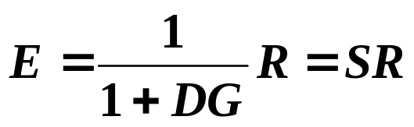
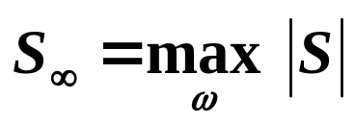
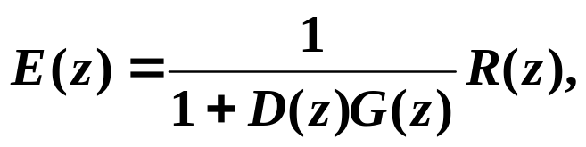
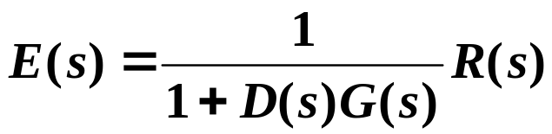
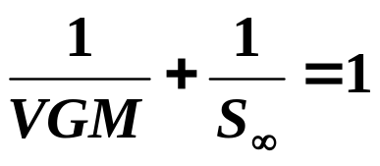
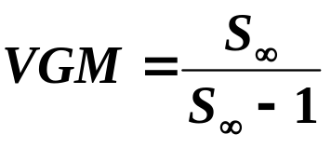
Sensitivity Function
Σ
See Figure 7.23 of text.
Vector Gain Margin (VGM) is the worst case gain margin.
Im(DG)
Re(DG)

Slide 8
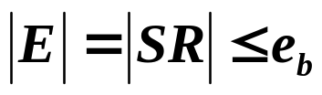
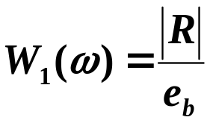
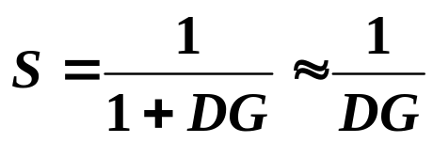

We can express more complete frequency domain design specifications than any of these margins (PM, GM, VGM) if we first give frequency descriptions for the external reference (and disturbance) signals:
  Generally, we’d like the system to track inputs (or reject disturbances) with frequency content up to a certain frequency.
  To normalize problem without defining spectrum of R and the error bound e_{b} each time, define a real function of frequency:
want |S| small

Slide 9





Stability Robustness
Usually it is expected that the control design works for a range of plants about the model used in designing the controller.
Σ
Magnitude function representing size of possible changes in plant; satisfies:
Represents uncertainty in phase; satisfies

Slide 10




Stability robustness means the control design for G₀ will lead to a stable system for all for all and
In particular:
If there is stability robustness:

Slide 11
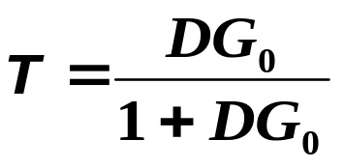

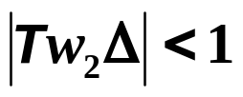
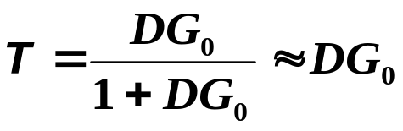
Complementary Sensitivity Function
is satisfied if
At high frequencies where there is usually more model uncertainty and W₂ is large, want DG₀ to be small.

Slide 12
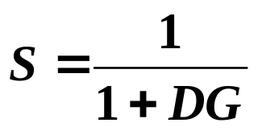
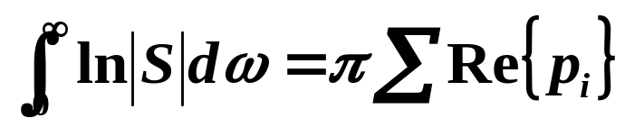
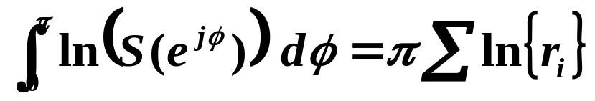
Sensitivity Integral
For continuous-time systems:
p_{i} are the unstable (RHP) poles of DG
Assumes:
DG roll-off at high frequencies is at a slope faster than -1
all zeros of DG are minimum phase (LHP)
For discrete-time systems:
r_{i} are the magnitudes of the unstable (outside U.C.) poles of DG

